Slide 1
Graduate project
Kh-031.QC
softserve
Notes:
Формат:
Заголовок: Proxima Nova (44?) Более жирный
Как-то так
Текст: Calibri 36 Если не влазит, то наверно можно меньше
Вот так

Slide 2
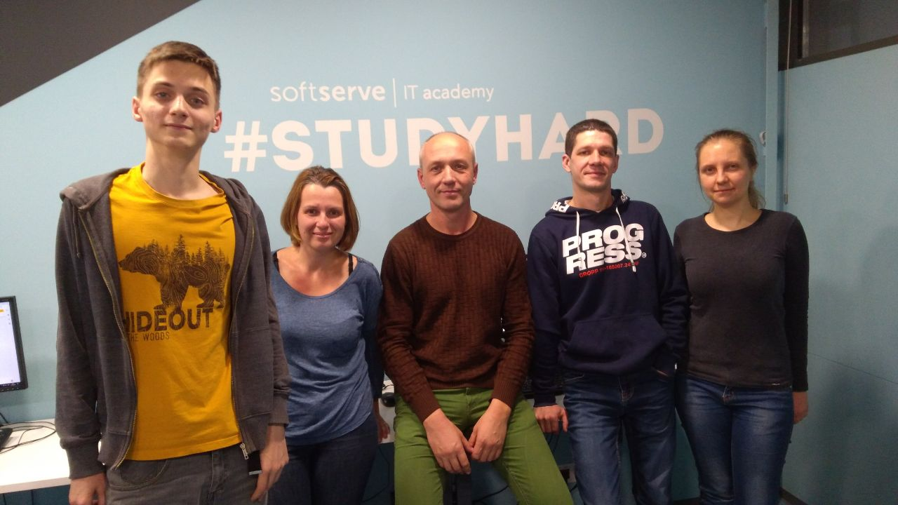
Our Team
Ярослав Света Сергей Саша Лена
softserve

Slide 3
Agenda
1. Who is QA?
2. What is quality?
3. Test documentation
4. Test types
5. Test levels
6. Test methods
7. Test techniques
8. Our project
softserve
Notes:
1. Ярик: отличия(куа, куси, тестер), что такое тестирование…..
2. Лена: что такое качество, по каким критериям определяется качественный ли продукт?
3. Света: тест план, тест стратегия, тест политика, чек лист, тест кейс, баг репорт, тест репорт
4. Сергей: Статическое и динамическое тестирование, Ручное и автоматизированное
5. Саша: все техники
6. Ярик: уровни
7. Сергей: методы
8. Лена: в качестве тестируемого По была выбрана баг-трекинговая система Мантис………..
Была проделана следующая работа:
1. Разработан тест план
2. Разработаны чек листы по видам тестирования
3. Разработаны тест-кейсы по видам и техникам тестирования
4. Проведено непосредственное тестирование
5. Выявлены дефекты и заведены баг-репорты
6. Проведен анализ результатов
Света: описать ВАШ тест план и общий чек-лит, но за каждый раздел, есть ответственный куа
КАЖДЫЙ ПО СВОЕМУ: описать вид, потом описать используемые техники, потом показать свой чек-лист, потом показать свой тест план, потом показать свой баг репорт(ы)
Света: итого тот же самый чек-лист только с результатами прохождения тестов.

Slide 4
Who is QA?
Quality Assurance
Quality Control
Testing
softserve

Slide 5
What is quality?
Quality
Functionality
Efficiency
Reliability
Portability
Usability
Maintainability
softserve

Slide 6
Test Documentation
Test Strategy
Test Plan
Checklist
Test Cases
Bug Reports
Test Report

Slide 7
Base Test Levels
Acceptance
System
Integration
Unit
softserve

Slide 8
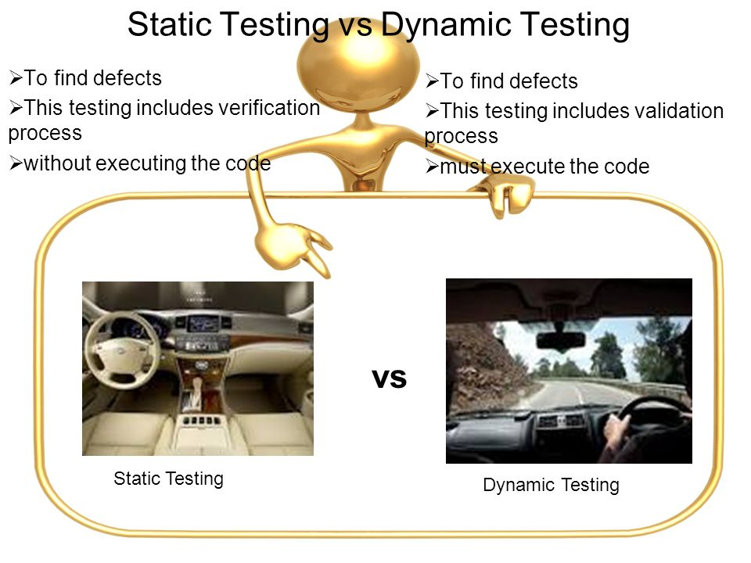

Static & Dynamic Testing
code is being examined without being executed
code is being executed
Static testing
Dynamic testing
softserve
8

Slide 9

Test Types: Manual and Automation testing
softserve
9

Slide 10
Testing methods
Black-box Testing
White-box Testing
Grey-box Testing
softserve
softserve

Slide 11
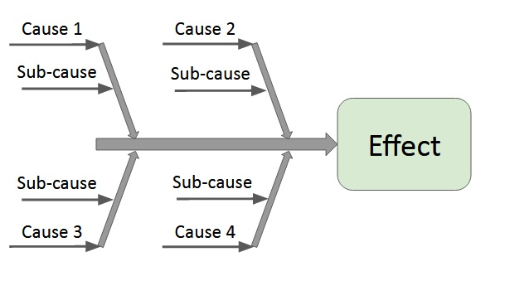
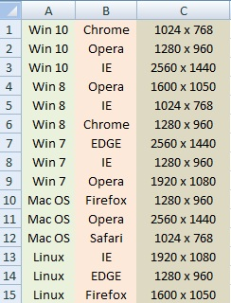
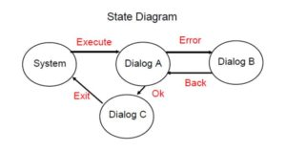
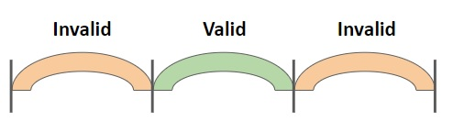
Test Design Techniques
Equivalence Partitioning
Boundary Values Analysis
Pairwise Testing
State Transition Diagram
Decision Tables
Cause/Effect
Error Guessing
Exhaustive Testing
 | Rule 1 | Rule 2 | Rule 3 | Rule 4
Condition 1 | Y | N | N | Y
Condition 2 | N | Y | N | N
Condition 3 | N | N | Y | N
softserve
Notes:
В представленном проекте мы использовали совокупность некоторых техник.
В частности:
Парное тестирование (применили в кроссбраузерном тестировании)
Анализ граничных значений (применили при тестировании полей в которые вводятся какие либо данные)
Классы эквивалентности (применили при тестировании в частности текстовых полей)
Предугадывание ошибок (применили основываясь на знаниях о системе)
Все эти техники мы применяем для того чтобы минимизировать количество тестов, и, как следствие, уменьшить финансовые и временные затраты на тестирование.

Slide 12
Our project:
Testing
Mantis bug tracker
softserve

Slide 13
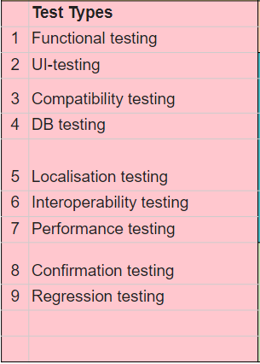
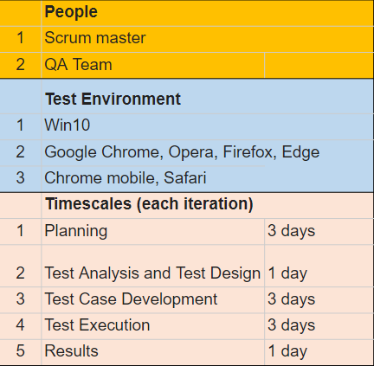
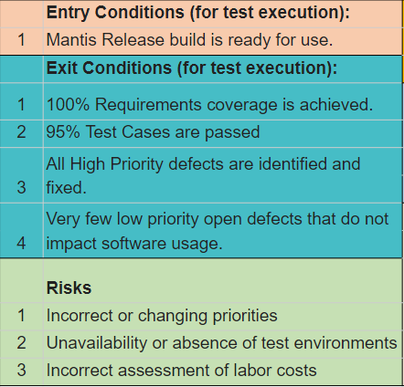
Test Plan
 | Project Name: Mantis | Introduction: Mantis, the bug-tracking system
Date of Beginning: 17.09.2019
Date of Ending: 30.09.2019 |  | Principles: early testing, optimal amount of documentation, preventing bugs, spreading quality ideas to the whole team
 | Test Types |  | Entry Conditions (for test execution): |  | People
1 | Functional testing | 1 | Mantis Release build is ready for use. | 1 | Scrum master
2 | UI-testing |  | Exit Conditions (for test execution): | 2 | QA Team
3 | Compatibility testing | 1 | 100% Requirements coverage is achieved. |  | Test Environment
4 | DB testing | 2 | 95% Test Cases are passed | 1 | Win10
5 | Localisation testing | 3 | All High Priority defects are identified and fixed. | 2 | Google Chrome, Opera, Firefox, Edge
 |  |  |  | 3 | Chrome mobile, Safari
6 | Interoperability testing | 4 | Very few low priority open defects that do not impact software usage. |  | Timescales (each iteration)
7 | Performance testing |  |  | 1 | Planning | 3 days
8 | Confirmation testing |  | Risks | 2 | Test Analysis and Test Design | 1 day
9 | Regression testing | 1 | Incorrect or changing priorities | 3 | Test Case Development | 3 days
 |  | 2 | Unavailability or absence of test environments | 4 | Test Execution | 3 days
 |  | 3 | Incorrect assessment of labor costs | 5 | Results | 1 day
softserve
Notes:
Safari
mobile version

Slide 14
Project Checklist
# | Summary | Deadline | Tester
1 | Functional testing | 22.09 | Elena
2 | API testing | 28.09 | Serhii
3 | User Interface testing | 22.09 | Oleksandr
4 | Compatibility testing | 28.09 | Svetlana
5 | Database testing | 23.09 | Yaroslav
6 | Localisation testing | 28.09 | Yaroslav
7 | Interoperability testing | 24.09 | Svetlana
8 | Performance testing | 24.09 | Serhii
softserve
Notes:
сделайте не сплюснутій
заменить слово приоритет

Slide 15
Functional Checklist
# | Functional Checklist | Status
1 | Check that administrator can create a project | Pass
2 | Check that admin can assign different roles for a project | Pass
3 | Check that manager/reporter can create issue in particular project | Pass
4 | Check that manager/reporter can assign created issue to developer(change issue status to assigned) | Pass
5 | Check that developer can change status of issue (to resolved) | Pass
6 | Check that manager/reporter can change status of issue (to closed) | Pass
7 | Check that notification are sent to email when assigning an issue to assignee | Pass
softserve

Slide 16
Functional Test Case
ID Kh-031.QC.001
Summary Verify that user can create issue
Priority High
Credentials Log in as a manager (tester1: tester1/123456)
Steps 1) Log in as a manager
2)Select the project
3) Click on 'Report issue' on Side bar or Navigation bar
4)Fill in required fields
5) Click on 'Submit issue'
6)Click on 'View issue' to check that issue was created
Expected result New issue was created.
softserve

Slide 17
User Interface Checklist
# | User Interface Checklist | Status
1 | The content of the web page is correct, without grammar or spelling errors. | Pass
2 | All fonts meet the requirements. | Pass
3 | All texts are correctly aligned. | Fail
4 | All error messages are correct, without spelling and grammar errors, and correspond to the title. | Pass
5 | Tips exist for all fields. | Fail
6 | All fields are correctly aligned. | Pass
7 | All buttons should have a standard format and size. | Pass
8 | The link to the home page should be on each page of the site. | Pass
9 | Check the TAB is working properly. | Fail
10 | Check the site with different screen resolutions (1280 x 1024, 1366 x 768, 1600 x 1050, 1920 x 1080) | Pass
11 | The scroll bar should appear only when required. | Pass
12 | Check that there are no broken links or images on the site. | Pass
softserve
Notes:
сделать в человеческом виде
оезультаті віполнения тестов+1 тест кейс+1 баг-репорт

Slide 18
User Interface Test Case
ID Kh-031.QC.002
Summary Check tabulation on “Report Issue” page.
Priority High
*Credentials Log in as a manager (tester1: tester1/123456)
Steps 1) Log In as a manager.
2) Click on “Create Issue” button.
3) Check that all controls, fields and links are highlighted consistently when pressing “Tab” button on keyboard.
Expected result All fields are selected sequentially during tabulation.
softserve

Slide 19
User Interface Bug Report
ID Kh-031.QC.BR.001
Summary The “Attach Tags” text field is not selected by “Tab” button.
Severity Low
Priority Low
*Credentials Log in as a manager (tester1: tester1/123456)
Environment Win 10, Chrome, Firefox, EDGE
Steps to 1) Log In as a manager.
reproduce 2) Click on “Create Issue” button.
3) Press the “Tab” button 6 times.
Expected result The “Attach Tags” field is selected and allow to enter
text.
Actual result The “Existing Tags” drop-down list is selected.
softserve

Slide 20
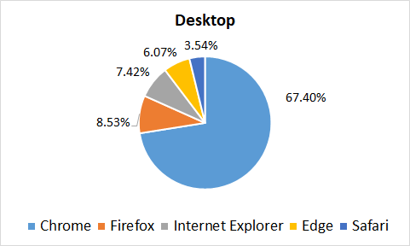
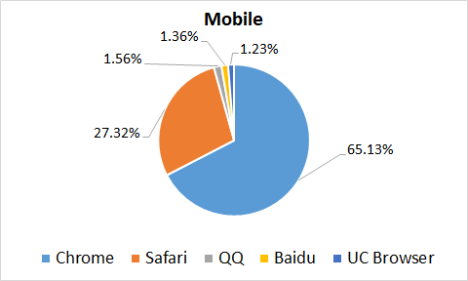
Compatibility Testing
Most frequently used browsers 06.2019-08.2019 according to Netmarketshare.com
softserve
Notes:
Разбить на 2 диаграммы - ПК и мобильные браузеры

Slide 21
Compatibility Checklist
# | Compatibility Checklist | Environment | Status
1 | Check that all buttons and fields at ‘Report Issue’ Page are match to mock-ups (UI) | Chrome, Firefox, IE, Edge | Pass
 |  | Chrome Mobile, Safari
2 | Check the main functionality of ‘Report Issue’ Page | Chrome, Firefox, IE, Edge | Pass
 |  | Chrome Mobile, Safari
softserve

Slide 22
Interoperability Testing
# | Interoperability Checklist | Status
1 | Check that new user receives a notification email after registration | Pass
2 | Check that user receives a notification email after assign issue to him | Pass
softserve
Notes:
Проверить письмо с нотификацией при добавлении нового юзера

Slide 23
Interoperability Test Case
ID Kh-031.QC.003
Summary Check that new user receives a notification email after registration
Priority Medium
*Credentials: administrator (admin/12345),user (user@gmail.com/12345)
Steps 1) Log in as administrator
2) Register a new user with email user@gmail.com
3) Open Gmail as a new user
4) Verify that notification email is received
5) Click on link in notification email
6) Make sure the registration confirmation page is displayed
Expected result The registration confirmation page is displayed. Registration is
completed.
softserve

Slide 24
Database Testing
# | Database Checklist | Status
1 | Test creating issue | Pass
2 | Test editing issue | Pass
3 | Test deleting issue | Pass
4 | Test creating invalid issue | Pass
softserve

Slide 25
Database Test Case
ID: Kh-031.QC.004
Summary: Verify that issue is added to the db
Priority: High
*Credentials: DB(administrator/), Mantis(Yaroslav/1234)
Steps:
Go to 'Report issue' tab
Enter a summary
Enter a description
Click 'Submit issue'
Note issue number displayed
Go to DB console
Enter a query and fill in <issue id>
Expected result: One row is displayed and
summary, description and username match the entered
SELECT a.id, summary, description, username from mantis_bug_table a JOIN mantis_bug_text_table b
on a.id = b.id
JOIN mantis_user_table c
on a.reporter_id = c.id
where a.id = <issue id>
softserve
Notes:
Можно вот это показать
https://www.mantisbt.org/docs/master/en-US/Developers_Guide/html/images/erd.png

Slide 26
Localisation Testing
# | Localisation Checklist | Status
1 | Test English localisation | Pass
2 | Test Russian localisation | Pass
3 | Test Arabic localisation | Pass
4 | Test Japanese localisation | Pass
5 | Test timezones(UTC, -6, +10) | Pass
softserve

Slide 27
Performance testing
# | Performance Checklist | Status
1 | Load testing | Pass
2 | Stress testing | Pass
3 | Volume testing | Pass
softserve

Slide 28
Test Case
ID Kh-031.QC.005
Summary
Check the stability of the program under a gradually increasing virtual user load
Priority
Medium
Steps
1) Add 1000 users to the system
2) Create a script that emulates users behaviour (e.g. can create, modify and delete issues)
3) Run the script in loop increasing users from 10 to 1000
4) Check response time
Expected result:
Response time equals or less than 5 sec
softserve

Slide 29

API Testing
# | API Checklist | Status
1 | Creating new user | Pass
2 | Getting user info (check user creation) | Pass
3 | Deleting created user | Pass
softserve

Slide 30
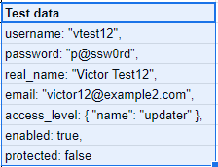
Test Case
ID Kh-031.QC.006
Summary
Check the functionality of adding a new user using REST API
Priority
High
Preconditions
Get administrator rights for sending request with permission to create users
Steps
1) Create a request using POST method
2) Use test data for request body
3) Send the request
4) Check in Mantis that new user is added and credentials are as in Test Data
Expected result
New user with given credentials is created
softserve

Slide 31
Test Report
# | Test types | Test Cases | Bug-reports
1 | Functional testing | 7 Pass/0 Failed
2 | API testing | 3 Pass/0 Failed
3 | User Interface testing | 14 Pass/3 Failed | 3 Low priority bugs logged
4 | Compatibility testing | 2 Pass/0 Failed
5 | Database testing | 4 Pass/0 Failed
6 | Localisation testing | 4 Pass/0 Failed
7 | Interoperability testing | 1 Pass/0 Failed
8 | Performance testing | 3 Pass/0 Failed
softserve

Slide 32
WELCOME TO THE FUTURE

